Slide 1
Unit 1 Introduction [6hrs]
Presented by
Er.Harendra Bikram Shah
Lecturer
Department of Computer Engineering
NAST

Slide 2
OUTLINES
Introduction to Cloud and Cloud Computing
History of Cloud Computing
Different Cloud Models
Benefits

Slide 3
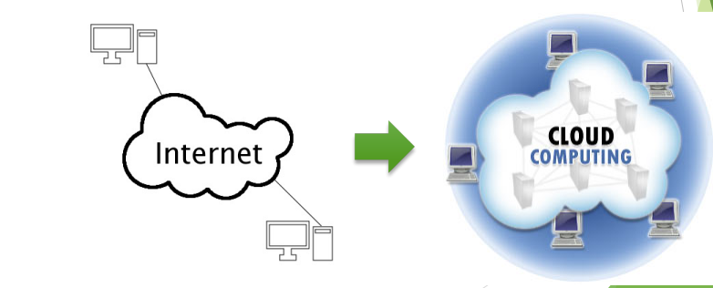
Introduction
What is Cloud?
The term Cloud refers to a Network or Internet. In other words, we can say that Cloud is something, which is present at remote location.

Slide 4
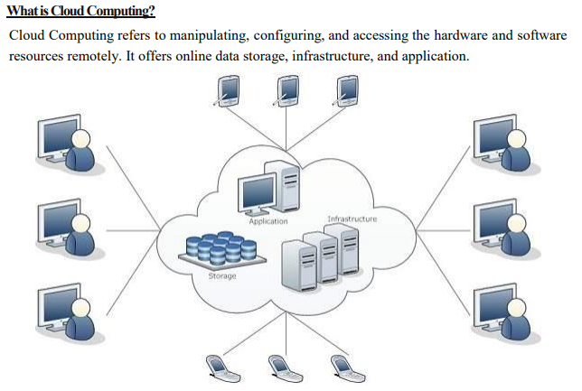
Introduction

Slide 5
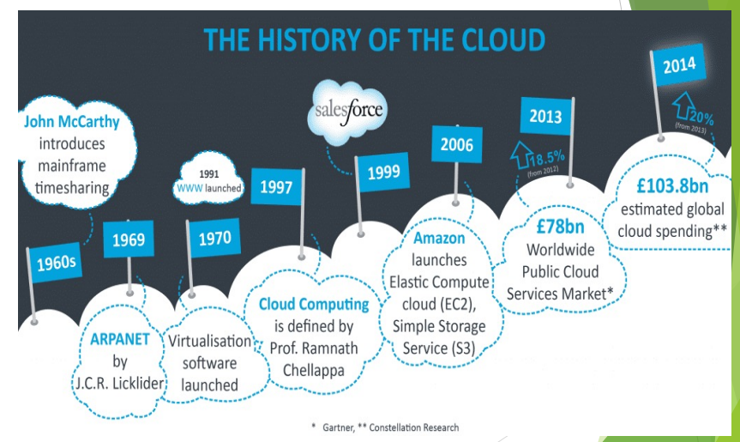
History

Slide 6
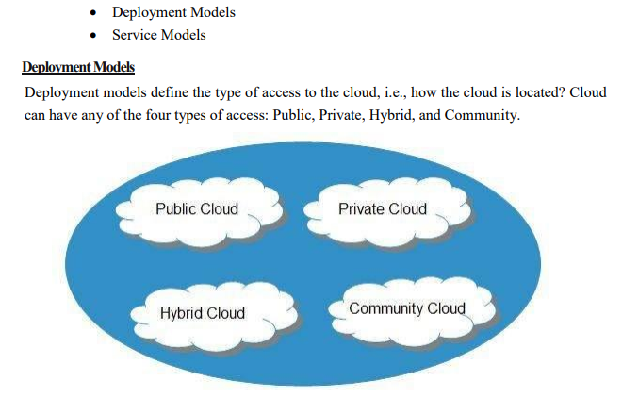
cloud Models

Slide 7
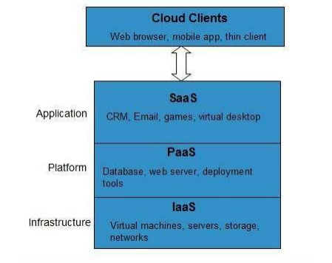
Cloud Models based on Service

Slide 8
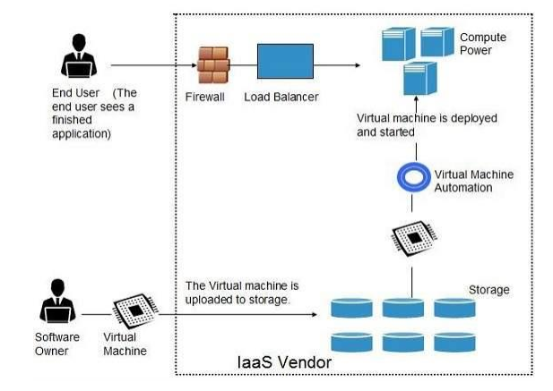
IAAS

Slide 9
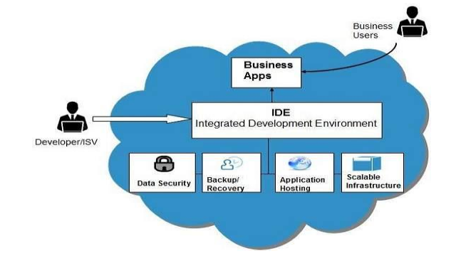
PAAS

Slide 10
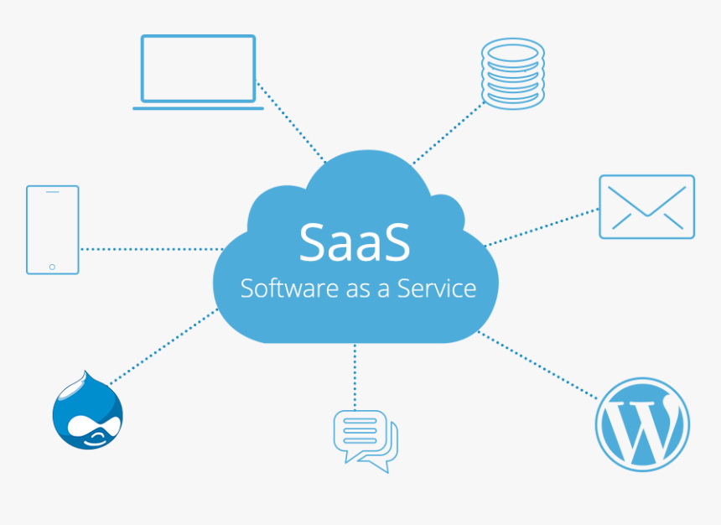
SAAS

Slide 11
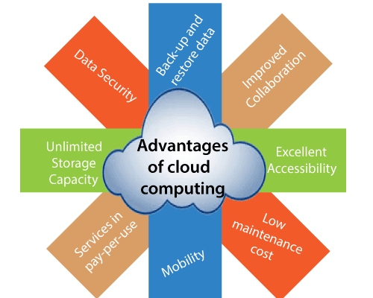
Benefits

Slide 12
Disadvantages
Internet Connectivity
Vendor lock-in
Limited Control
Security and Privacy
Cost concerns

Slide 13
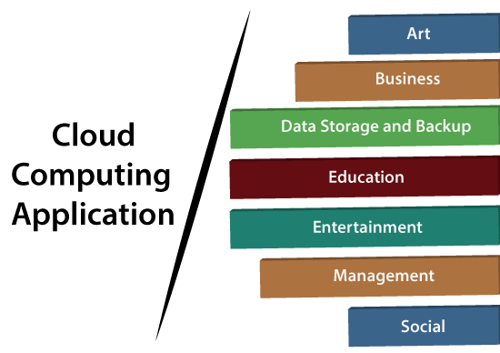
Applications

Slide 14
Applications
Art Applications : Examples: Moo, Vistaprint, Adobe creative Cloud
Business Applications: Examples: PayPal, Salesforce
Data Storage and Backup Applications : Examples: Google G suite, Box.Com
Education Applications: Examples: Google Apps for Education, AWS in Education
Entertainment Applications: Example: Online Games , video Conferencing Apps
Management Applications: Examples: GoToMeeting, outright, Evernote
Social Applications: Facebook, YouTube, Instagram

Slide 15
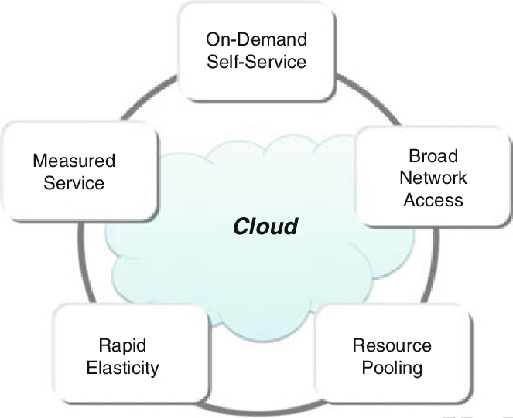
Characteristics

Slide 16
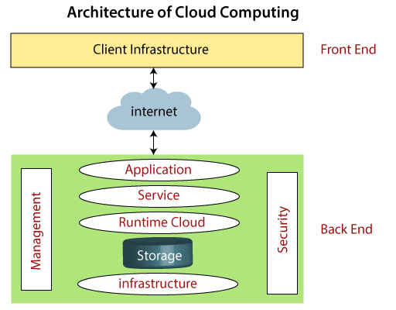

Slide 17
Components of Cloud Computing
Client Infrastructure
Application
Service
Run time Cloud
Storage
Security
Infrastructure
Management
Internet

Slide 18
Differences between Cloud computing and Grid Computing
Cloud Computing | Grid Computing
Cloud Computing follows client-server computing architecture. | Grid computing follows a distributed computing architecture.
Scalability is high. | Scalability is normal.
Cloud Computing is more flexible than grid computing. | Grid Computing is less flexible than cloud computing.
Cloud operates as a centralized management system. | Grid operates as a decentralized management system.
In cloud computing, cloud servers are owned by infrastructure providers. | In Grid computing, grids are owned and managed by the organization.
Cloud computing uses services like Iaas, PaaS, and SaaS. | Grid computing uses systems like distributed computing, distributed information, and distributed pervasive.
Cloud Computing is Service-oriented. | Grid Computing is Application-oriented.
It is accessible through standard web protocols. | It is accessible through grid middleware.

Slide 19
Ethical Issues in Cloud
the control is relinquished to third party services
the data is stored on multiple sites administered by several organizations
multiple services interoperate across the network.

Slide 20
Vulnerabilities/Threat in Cloud Computing
Misconfigured Cloud Storage
Loss or Theft of Intellectual Property
Loss of Control Over End-User Actions
Poor Access Management
Insecure APIs

Slide 21
End of the UNIT

